Slide 1
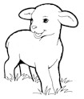
Adventurer Pledge:
Because Jesus loves
me, I will always
do my best!!!
Little Lambs
Little Lambs Class:
Name:
Instructors:
Class:
Adventurer Law
Jesus can help me to:
Be Obedient
Be Pure
Be True
Be Kind
Be Respectful
Be Attentive
Be Helpful
Be Cheerful
Be Thoughtful
Be Reverent
Club
Name

Slide 2
Awards Earned:

